Slide 1
Java Collections

Slide 2
Collections in Java
Collections in java is a framework that provides an architecture to store and manipulate the group of objects.
All the operations that you perform on a data such as searching, sorting, insertion, manipulation, deletion etc. can be performed by Java Collections.
Java Collection simply means a single unit of objects

Slide 3
What is Collection in java
Collection represents a single unit of objects i.e. a group.
Group of different type of objects
In Arrays we can store only similar type of elements

Slide 4
What is framework in java
provides readymade architecture.
represents set of classes and interface.
Semi finished application

Slide 5
What is Collection framework
Collection framework represents a unified architecture for storing and manipulating group of objects. It has:
Interfaces and its implementations i.e. classes
Algorithm
The java.util package contains all the classes and interfaces for Collection framework.

Slide 6
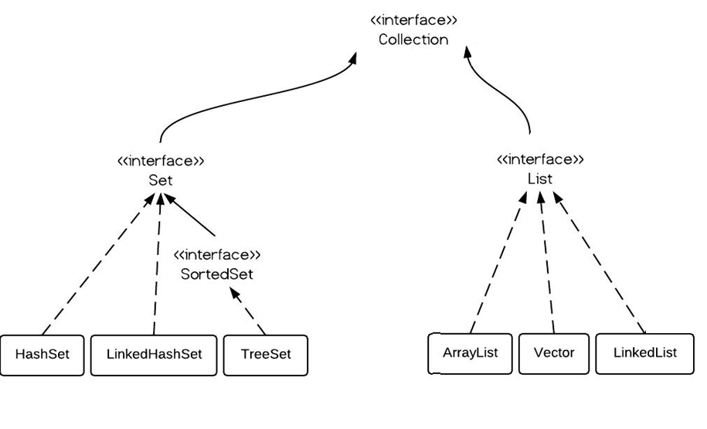
Hierarchy of Collection Framework

Slide 7
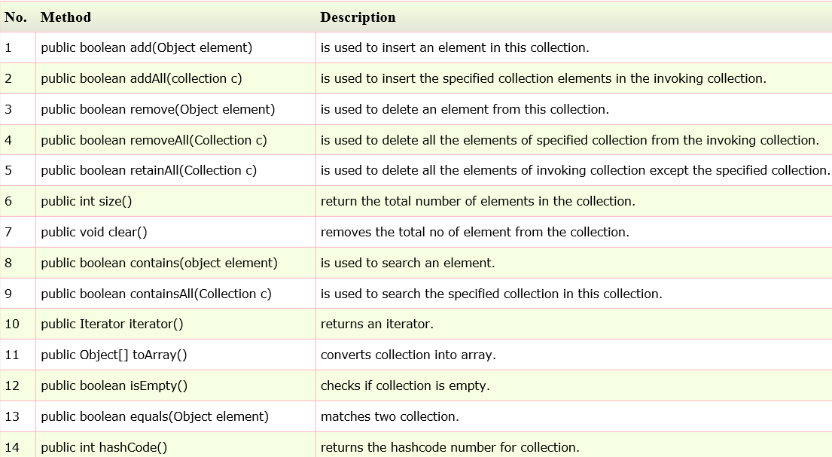
Methods of Collection interface

Slide 8
Java Collection framework provides many interfaces
List
Set
Map
etc

Slide 9
Java Collection framework provides many classes
ArrayList
Vector
LinkedList
HashSet
LinkedHashSet
TreeSet etc

Slide 10
Java List Interface
List Interface is the subinterface of Collection.It contains methods to insert and delete elements in index basis.It is a factory of ListIterator interface.
Commonly used methods of List Interface:
public void add(int index,Object element);
public boolean addAll(int index,Collection c);
public object get(int Index position);
public object set(int index,Object element);
public object remove(int index);
public ListIterator listIterator();
public ListIterator listIterator(int i);

Slide 11
Iterator interface
Iterator interface provides the facility of iterating the elements in forward direction only.
Methods of Iterator interface
There are only three methods in the Iterator interface. They are:
public boolean hasNext() it returns true if iterator has more elements.
public object next() it returns the element and moves the cursor pointer to the next element.
public void remove() it removes the last elements returned by the iterator. It is rarely used.

Slide 12
Java ArrayList class
Java ArrayList class uses a dynamic array for storing the elements.It extends AbstractList class and implements List interface.
Java ArrayList class can contain duplicate elements.
Java ArrayList class maintains insertion order.
Java ArrayList class is non synchronized.
Java ArrayList allows random access because array works at the index basis.
In Java ArrayList class, manipulation is slow because a lot of shifting needs to be occurred if any element is removed from the array list.

Slide 13
Example of Java ArrayList class with out generics
public class ArrayListTest {
public static void main(String[] args) {
ArrayList al = new ArrayList();
al.add("Mounika"); //add string value
al.add(101); //add integer value
al.add(123.33); //add double value
al.add('c'); //add character value
al.add(true); //add boolean value
Iterator iterator = al.iterator();
while(iterator.hasNext()){
System.out.println(iterator.next());
}
}
}

Slide 14
Java Non-generic Vs Generic Collection
Java collection framework was non-generic before JDK 1.5. Since 1.5, it is generic.
Java new generic collection allows you to have only one type of object in collection. Now it is type safe so typecasting is not required at run time.

Slide 15
old non-generic example of creating java collection.
ArrayList al=new ArrayList();//creating old non-generic arraylist

Slide 16
new generic example of creating java collection.
ArrayList<String> al=new ArrayList<String>();//creating new generic arraylist

Slide 17
Example of Java ArrayList class with generics
import java.util.*;
class TestCollection1{
public static void main(String args[]){
ArrayList<String> al=new ArrayList<String>();//creating arraylist
al.add("Ravi");//adding object in arraylist
al.add("Vijay");
al.add("Ravi");
al.add("Ajay");
Iterator itr=al.iterator();//getting Iterator from arraylist to traverse elements
while(itr.hasNext()){
System.out.println(itr.next());
}
}
}

Slide 18
output
Ravi
Vijay
Ravi
Ajay

Slide 19
Two ways to iterate the elements of collection in java
By Iterator interface.
By for-each loop.
In the above example, we have seen traversing ArrayList by Iterator. Let's see the example to traverse ArrayList elements using for-each loop.

Slide 20
Iterating the elements of Collection by for-each loop
import java.util.*;
class TestCollection2{
public static void main(String args[]){
ArrayList<String> al=new ArrayList<String>();
al.add("Ravi");
al.add("Vijay");
al.add("Ravi");
al.add("Ajay");
for(String obj:al)
System.out.println(obj);
}
}

Slide 21
User-defined class objects in Java ArrayList
class Student{
int rollno;
String name;
int age;
Student(int rollno,String name,int age){
this.rollno=rollno;
this.name=name;
this.age=age;
}
}

Slide 22
TestCollection.java
public class TestColllection{
public static void main(String[] args) {
Student s1 = new Student(103, "Tharun", 23);
Student s2 = new Student(102, "Akhil", 21);
Student s3 = new Student(101, "Sameer", 22);
ArrayList<Student> studentsList = new ArrayList<Student>();
studentsList.add(s1);
studentsList.add(s2);
studentsList.add(s3);
Iterator<Student> studentIterator = studentsList.iterator();
while(studentIterator.hasNext()){
Student student = studentIterator.next();
System.out.println(student.id+" "+student.name+" "+student.age);
}
}
}

Slide 23
Output
101 Sonoo 23
102 Ravi 21
103 Hanumat 25

Slide 24
Example of addAll()
import java.util.ArrayList;
public class AddAllDemo {
public static void main(String[] args) {
ArrayList al1 = new ArrayList<>();
al1.add("NTR");
al1.add("ANR");
al1.add("Jr. NTR");
ArrayList al2 = new ArrayList();
al2.add("KCR");
al2.add("KTR");
al2.add("Kavitha");
al1.addAll(al2);
System.out.println(al1);
}
}

Slide 25
Example of removeAll()
import java.util.ArrayList;
public class AddAllDemo {
public static void main(String[] args) {
ArrayList al1 = new ArrayList<>();
al1.add("NTR");
al1.add("ANR");
al1.add("Jr. NTR");
ArrayList al2 = new ArrayList();
al2.add("KCR");
al2.add("KTR");
al2.add("Kavitha");
al1.removeAll(al2);
System.out.println(al1);
}
}

Slide 26
Example of retainAll() method
import java.util.ArrayList;
public class AddAllDemo {
public static void main(String[] args) {
ArrayList al1 = new ArrayList<>();
al1.add("NTR");
al1.add("ANR");
al1.add("Jr. NTR");
ArrayList al2 = new ArrayList();
al2.add("KCR");
al2.add("KTR");
al2.add("Kavitha");
al1.retainAll(al2);
System.out.println(al1);
}
}

Slide 27
output
iterating the elements after retaining the elements of al2... Ravi

Slide 28
Vector
Vector is a legacy class.
Vector is synchronized class
Vector uses Enumeration interface to traverse the elements. But it can use Iterator also.

Slide 29
Example of Vector
public class VectorTest {
public static void main(String[] args) {
Vector<String> v = new Vector<>(10);
v.add("Ajay");
v.add("Rakesh");
v.add("Jhansi");
v.add("Bindu");
System.out.println(v);
System.out.println("using Enumeration");
Enumeration<String> e = v.elements();
while (e.hasMoreElements()) {
System.out.println(e.nextElement());
}
System.out.println("using iterator");
Iterator<String> iterator = v.iterator();
while (iterator.hasNext()) {
System.out.println(iterator.next());
}}}

Slide 30
Vector and ArrayList
ArrayList and Vector both implements List interface and maintains insertion order.

Slide 31
***Difference between ArrayList and Vector
ArrayList | Vector
1) ArrayList is not synchronized. | Vector is synchronized.
2) ArrayList increments 50% of current array size if number of element exceeds from its capacity. | Vector increments 100% means doubles the array size if total number of element exceeds than its capacity.
3) ArrayList is not a legacy class, it is introduced in JDK 1.2. | Vector is a legacy class.
4) ArrayList is fast because it is non-synchronized. | Vector is slow because it is synchronized i.e. in multithreading environment, it will hold the other threads in runnable or non-runnable state until current thread releases the lock of object.
5) ArrayList uses Iterator interface to traverse the elements. | Vector uses Enumeration interface to traverse the elements. But it can use Iterator also.

Slide 32
Java LinkedList Example
Java LinkedList class uses doubly linked list to store the elements. It extends the AbstractList class and implements List and Deque interfaces.
Java LinkedList class can contain duplicate elements.
Java LinkedList class maintains insertion order.
Java LinkedList class is non synchronized.
In Java LinkedList class, manipulation is fast because no shifting needs to be occurred.
Java LinkedList class can be used as list, stack or queue.

Slide 33
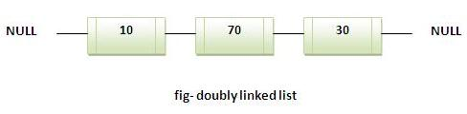
Linked list structure

Slide 34
Java Linkedlist Example:
import java.util.*;
public class TestCollection7{
public static void main(String args[]){
LinkedList<String> al=new LinkedList<String>();
al.add("Ravi");
al.add("Vijay");
al.add("Ravi");
al.add("Ajay");
Iterator<String> itr=al.iterator();
while(itr.hasNext()){
System.out.println(itr.next());
}
}
}

Slide 35
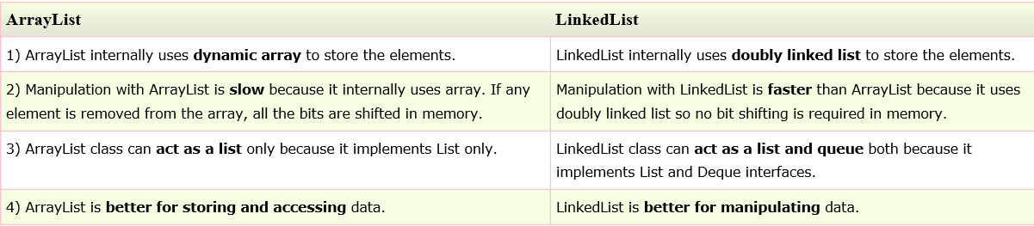
Difference between ArrayList and LinkedList
ArrayList and LinkedList both implements List interface and maintains insertion order. Both are non synchronized classes.
But there are many differences between ArrayList and LinkedList classes that are given below

Slide 36
Example of ArrayList and LinkedList in Java
import java.util.*;
class TestArrayLinked{
public static void main(String args[]){
List<String> al=new ArrayList<String>();//creating arraylist
al.add("Ravi");//adding object in arraylist
al.add("Vijay");
al.add("Ravi");
al.add("Ajay");
List<String> al2=new LinkedList<String>();//creating linkedlist
al2.add("James");//adding object in linkedlist
al2.add("Serena");
al2.add("Swati");
al2.add("Junaid");
System.out.println("arraylist: "+al);
System.out.println("linkedlist: "+al2);
}
}

Slide 37
Java ListIterator Interface
ListIterator Interface is used to traverse the element in backward and forward direction.
Commonly used methods of ListIterator Interface:
public boolean hasNext();
public Object next();
public boolean hasPrevious();
public Object previous();

Slide 38
Example of ListIterator Interface:
public static void main(String args[]){
ArrayList<String> al=new ArrayList<String>();
al.add("Amit");
al.add("Vijay");
al.add("Kumar");
al.add(1,"Sachin");
System.out.println("element at 2nd position: "+al.get(2));
Iterator<String> itr=al.listIterator();
System.out.println("traversing elements in forward direction...");
while(itr.hasNext()){
System.out.println(itr.next());
}
System.out.println("traversing elements in backward direction...");
while(itr.hasPrevious()){
System.out.println(itr.previous());
}
}
}

Slide 39
Difference Between Iterator and ListIterator
Iterator
List Iterator
Traverse collection elements in forward direction only
Traverse collection elements in forward and backward direction also.

Slide 40
Set interface
Implemented classes
Hashset
LinkedHashset
Treeset

Slide 41
Java HashSet class
uses hashtable to store the elements.It extends AbstractSet class and implements Set interface.
contains unique elements only.
Difference between List and Set:
List can contain duplicate elements whereas Set contains unique elements only.

Slide 42
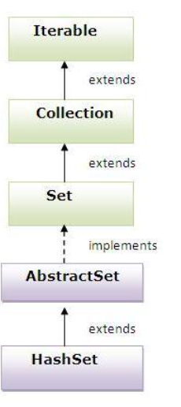
Hierarchy of HashSet class

Slide 43
Example of HashSet class
class TestCollection{
public static void main(String args[]){
HashSet<String> al=new HashSet<String>();
al.add("Ravi");
al.add("Vijay");
al.add("Ravi");
al.add("Ajay");
Iterator<String> itr=al.iterator();
while(itr.hasNext()){
System.out.println(itr.next());
}
}
}

Slide 44
Java LinkedHashSet class:
contains unique elements only like HashSet. It extends HashSet class and implements Set interface.
maintains insertion order.

Slide 45
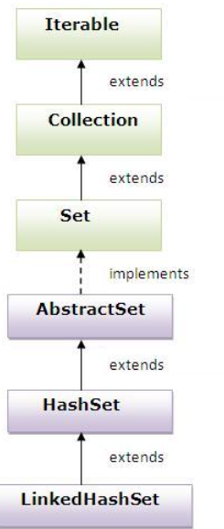
Hierarchy of LinkedHashSet class:

Slide 46
Example of LinkedHashSet class:
class TestCollection10{
public static void main(String args[]){
LinkedHashSet<String> al=new LinkedHashSet<String>();
al.add("Ravi");
al.add("Vijay");
al.add("Ravi");
al.add("Ajay");
Iterator<String> itr=al.iterator();
while(itr.hasNext()){
System.out.println(itr.next());
}
}
}

Slide 47
Java TreeSet class
contains unique elements only like HashSet. The TreeSet class implements NavigableSet interface that extends the SortedSet interface.
maintains ascending order.

Slide 48
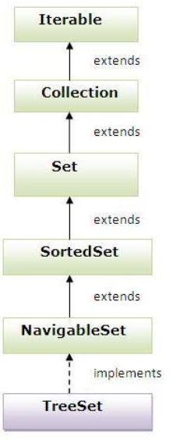
TreeSet Hierarchy

Slide 49
Example of TreeSet class:
import java.util.*;
class TestCollection11{
public static void main(String args[]){
TreeSet<String> al=new TreeSet<String>();
al.add("Ravi");
al.add("Vijay");
al.add("Ravi");
al.add(“AAJY");
al.add("Ajay");
Iterator<String> itr=al.iterator();
while(itr.hasNext()){
System.out.println(itr.next());
}
}
}

Slide 50
****Guess the output
public class TreesetDemo {
public static void main(String[] args) {
TreeSet ts = new TreeSet();
ts.add("AMR");
ts.add("NTR");
ts.add(new StringBuffer("ANR"));
System.out.println(ts);
}
}

Slide 51
output
Exception in thread "main" java.lang.ClassCastException: java.lang.StringBuffer cannot be cast to java.lang.Comparable

Slide 52
****Guess the output
public class TreesetDemo {
public static void main(String[] args) {
TreeSet ts = new TreeSet();
ts.add("AMR");
ts.add("NTR");
ts.add(null);
System.out.println(ts);
}
}

Slide 53
Output
Nullpointer Exception

Slide 54
Map Interface
A map contains values based on the key i.e. key and value pair.Each pair is known as an entry.Map contains only unique elements.
Commonly used methods of Map interface:
public Object put(object key,Object value): is used to insert an entry in this map.
public void putAll(Map map):is used to insert the specified map in this map.
public Object remove(object key):is used to delete an entry for the specified key.
public Object get(Object key):is used to return the value for the specified key.
public boolean containsKey(Object key):is used to search the specified key from this map.
public boolean containsValue(Object value):is used to search the specified value from this map.
public Set keySet():returns the Set view containing all the keys.
public Set entrySet():returns the Set view containing all the keys and values.

Slide 55
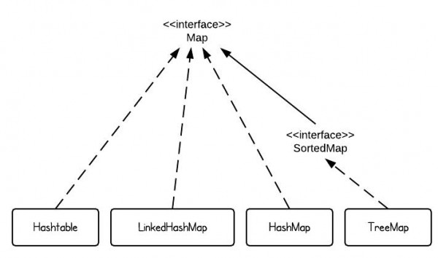
Hierarchy of Map interface

Slide 56
Entry
Entry is the subinterface of Map.So we will access it by Map.Entry name.It provides methods to get key and value.
Methods of Entry interface:
public Object getKey(): is used to obtain key.
public Object getValue():is used to obtain value.

Slide 57
Java HashMap class
A HashMap contains values based on the key. It implements the Map interface and extends AbstractMap class.
It contains only unique elements.
It may have one null key and multiple null values.
It maintains no order.

Slide 58
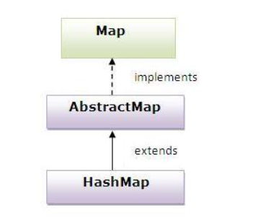
Hierarchy of HashMap class:

Slide 59
Example of HashMap class:
import java.util.*;
class TestCollection13{
public static void main(String args[]){
HashMap<Integer,String> hm=new HashMap<Integer,String>();
hm.put(100,"Amit");
hm.put(101,"Vijay");
hm.put(102,"Rahul");
for(Map.Entry m:hm.entrySet()){
System.out.println(m.getKey()+" "+m.getValue());
}
}
}

Slide 60
What is difference between HashSet and HashMap?
HashSet contains only values whereas HashMap contains entry(key and value).

Slide 61
Java LinkedHashMap class
A LinkedHashMap contains values based on the key. It implements the Map interface and extends HashMap class.
It contains only unique elements.
It may have one null key and multiple null values.
It is same as HashMap instead maintains insertion order.

Slide 62
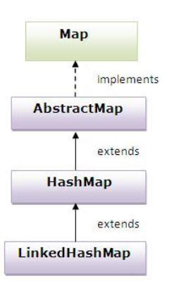
Hierarchy of LinkedHashMap class

Slide 63
Example of LinkedHashMap class:
import java.util.*;
class TestCollection14{
public static void main(String args[]){
LinkedHashMap<Integer,String> hm=new LinkedHashMap<Integer,String>();
hm.put(100,"Amit");
hm.put(101,"Vijay");
hm.put(102,"Rahul");
for(Map.Entry m:hm.entrySet()){
System.out.println(m.getKey()+" "+m.getValue());
}
}
}

Slide 64
Java TreeMap class
A TreeMap contains values based on the key. It implements the NavigableMap interface and extends AbstractMap class.
It contains only unique elements.
It cannot have null key but can have multiple null values.
It is same as HashMap instead maintains ascending order.

Slide 65
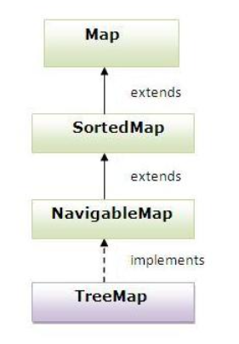
Hierarchy of TreeMap class:

Slide 66
Example of TreeMap class:
import java.util.*;
class TestCollection15{
public static void main(String args[]){
TreeMap<Integer,String> hm=new TreeMap<Integer,String>();
hm.put(100,"Amit");
hm.put(102,"Ravi");
hm.put(101,"Vijay");
hm.put(103,"Rahul");
for(Map.Entry m:hm.entrySet()){
System.out.println(m.getKey()+" "+m.getValue());
}
}
}

Slide 67
What is difference between HashMap and TreeMap?
1) HashMap can contain one null key.TreeMap can not contain any null key.
2) HashMap maintains no order.TreeMap maintains ascending order.

Slide 68
Hashtable class

Slide 69
Hashtable
A Hashtable is an array of list.Each list is known as a bucket.The position of bucket is identified by calling the hashcode() method.A Hashtable contains values based on the key. It implements the Map interface and extends Dictionary class.
It contains only unique elements.
It doesn’t allow key as null (if null is added- throws null pointer exception)
It is synchronized.

Slide 70
Example of Hashtable
class TestHashTable{
public static void main(String args[]){
Hashtable<Integer,String> hm=new Hashtable<Integer,String>();
hm.put(100,"Amit");
hm.put(102,"Ravi");
hm.put(101,"Vijay");
hm.put(103,"Rahul");
for(Map.Entry m:hm.entrySet()){
System.out.println(m.getKey()+" "+m.getValue());
}
}
}

Slide 71
Output
103 Rahul
102 Ravi
101 Vijay
100 Amit

Slide 72
***Difference between HashMap and Hashtable
HashMap and Hashtable both are used to store data in key and value form. Both are using hashing technique to store unique keys.
HashMap | Hashtable
1) HashMap is non synchronized. It is not-thread safe and can't be shared between many threads without proper synchronization code. | Hashtable is synchronized. It is thread-safe and can be shared with many threads.
2) HashMap allows one null key and multiple null values. | Hashtable doesn't allow any null key or value.
3) HashMap is a new class introduced in JDK 1.2. | Hashtable is a legacy class.
4) HashMap is fast. | Hashtable is slow.
5) We can make the HashMap as synchronized by calling this code Map m = Collections.synchronizedMap(hashMap); | Hashtable is internally synchronized and can't be unsynchronized.
6) HashMap is traversed by Iterator. | Hashtable is traversed by Enumerator and Iterator.
7) ) HashMap inherits AbstractMap class. | Hashtable inherits Dictionary class.

Slide 73
Properties class in Java
The properties object contains key and value pair both as a string. It is the subclass of Hashtable.
It can be used to get property value based on the property key. The Properties class provides methods to get data from properties file and store data into properties file. Moreover, it can be used to get properties of system.

Slide 74
Advantage of properties file
Easy Maintenance: If any information is changed from the properties file, you don't need to recompile the java class. It is mainly used to contain variable information i.e. to be changed.

Slide 75
Methods of Properties class
Method | Description
public void load(Reader r) | loads data from the Reader object.
public void load(InputStream is) | loads data from the InputStream object
public String getProperty(String key) | returns value based on the key.
public void setProperty(String key,String value) | sets the property in the properties object.
public void store(Writer w, String comment) | writers the properties in the writer object.
public void store(OutputStream os, String comment) | writes the properties in the OutputStream object.
storeToXML(OutputStream os, String comment) | writers the properties in the writer object for generating xml document.
public void storeToXML(Writer w, String comment, String encoding) | writers the properties in the writer object for generating xml document with specified encoding.

Slide 76
Example of Properties class to get information from properties file
To get information from the properties file, create the properties file first.

Slide 77
Db.properties
user=system
password=oracle

Slide 78
Test.java
public class Test {
public static void main(String[] args)throws Exception{
FileReader reader=new FileReader("db.properties");
Properties p=new Properties();
p.load(reader);
System.out.println(p.getProperty("user"));
System.out.println(p.getProperty("password"));
}
}

Slide 79
Note
Now if you change the value of the properties file, you don't need to compile the java class again. That means no maintenance problem.

Slide 80
Example of Properties class to get all the system properties
public class Test {
public static void main(String[] args)throws Exception{
Properties p=System.getProperties(); // get all the properties of system
Set set=p.entrySet();
Iterator itr=set.iterator();
while(itr.hasNext()){
Map.Entry entry=(Map.Entry)itr.next();
System.out.println(entry.getKey()+" = "+entry.getValue());
}
}
}

Slide 81
Example of Properties class to create properties file
public class Test {
public static void main(String[] args)throws Exception{
Properties p=new Properties();
p.setProperty("name",“Mangarao");
p.setProperty("email",“nomail@gmail.com");
p.store(new FileWriter("info.properties")," Properties Example");
System.out.println("Properties file created successfully");
}
}

Slide 82
Collections utility class provides static methods to convert non synchronized to synchronized objects
Convert List object as synchronized
ArrayList al = new ArrayList<>();
Collections.synchronizedList(al);
Convert Set object as synchronized
HashSet hs = new HashSet<>();
Collections.synchronizedSet(hs);
Convert Map object as synchronized
HashMap<Integer, String> hashMap = new HashMap<>();
Collections.synchronizedMap(hashMap);

Slide 83
Sorting
We can sort the elements of:
String objects
Wrapper class objects
User-defined class objects

Slide 84
Collections class
Collections class provides static methods for sorting the elements of collection.
If collection elements are of Set type, we can use TreeSet.But We cannot sort the elements of List.
Collections class provides methods for sorting the elements of List type elements.

Slide 85
Method of Collections class for sorting List elements
public void sort(List list)
It is used to sort the elements of List.
List elements must be of Comparable type.

Slide 86
Example of Sorting the elements of List that contains string objects
class TestSort{
public static void main(String args[]){
ArrayList<String> al=new ArrayList<String>();
al.add("Viru");
al.add("Saurav");
al.add("Mukesh");
al.add("Tahir");
Collections.sort(al);
Iterator itr=al.iterator();
while(itr.hasNext()){
System.out.println(itr.next());
}
}
}

Slide 87
Example of Sorting the elements of List that contains Wrapper class objects
class TestSort{
public static void main(String args[]){
ArrayList al=new ArrayList();
al.add(Integer.valueOf(201));
al.add(Integer.valueOf(101));
al.add(230);//internally will be converted into objects as Integer.valueOf(230)
Collections.sort(al);
Iterator itr=al.iterator();
while(itr.hasNext()){
System.out.println(itr.next());
}
}
}

Slide 88
Comparable interface
Comparable interface is used to order the objects of user-defined class.
This interface is found in java.lang package and contains only one method named compareTo(Object).
It provide only single sorting sequence i.e. you can sort the elements on based on single datamember only.
For instance it may be either rollno, name, age or anything else.

Slide 89
Syntax:
public int compareTo(Object obj): is used to compare the current object with the specified object.

Slide 90
Example of Sorting the elements of List that contains user-defined class objects on age basis
class Student implements Comparable{
int rollno;
String name;
int age;
Student(int rollno,String name,int age){
this.rollno=rollno;
this.name=name;
this.age=age;
}
public int compareTo(Object obj){
Student st=(Student)obj;
if(age==st.age)
return 0;
else if(age>st.age)
return 1;
else
return -1;
}
}

Slide 91
TestSort.java
class TestSort{
public static void main(String args[]){
ArrayList al=new ArrayList();
al.add(new Student(101,"Vijay",23));
al.add(new Student(106,"Ajay",27));
al.add(new Student(105,"Jai",21));
Collections.sort(al);
Iterator itr=al.iterator();
while(itr.hasNext()){
Student st=(Student)itr.next();
System.out.println(st.rollno+""+st.name+""+st.age);
}
}
}

Slide 92
Comparator interface

Slide 93
Comparator
Comparator interface is used to order the objects of user-defined class.
This interface is found in java.util package and contains 2 methods compare(Object obj1,Object obj2) and equals(Object element).
It provides multiple sorting sequence i.e. you can sort the elements based on any data member. For instance it may be on rollno, name, age or anything else.

Slide 94
Syntax of compare method
public int compare(Object obj1,Object obj2):
//compares the first object with second object.

Slide 95
Example of sorting the elements of List that contains user-defined class objects on the basis of age and name
In this example we are creating following classes
Student.java
AgeComparator.java
NameComparator.java
SimpleTest.java

Slide 96
Student.java
class Student{
int rollno;
String name;
int age;
Student(int rollno,String name,int age){
this.rollno=rollno;
this.name=name;
this.age=age;
}
}

Slide 97
AgeComparator
This class defines comparison logic based on the age. If age of first object is greater than the second, we are returning positive value, it can be any one such as 1, 2 , 10 etc. If age of first object is less than the second object, we are returning negative value, it can be any negative value and if age of both objects are equal, we are returning 0.

Slide 98
AgeComparator.java
class AgeComparator implements Comparator{
public int Compare(Object o1,Object o2){
Student s1=(Student)o1;
Student s2=(Student)o2;
if(s1.age==s2.age)
return 0;
else if(s1.age>s2.age)
return 1;
else
return -1;
}
}

Slide 99
NameComparator.java
This class provides comparison logic based on the name. In such case, we are using the compareTo() method of String class, which internally provides the comparison logic.

Slide 100
NameComparator.java
import java.util.*;
class NameComparator implements Comparator{
public int Compare(Object o1,Object o2){
Student s1=(Student)o1;
Student s2=(Student)o2;
return s1.name.compareTo(s2.name);
}
}

Slide 101
SimpleTest.java
ArrayList al=new ArrayList();
al.add(new Student(101,"Vijay",23));
al.add(new Student(106,"Ajay",27));
al.add(new Student(105,"Jai",21));
System.out.println("Sorting by Name...");
Collections.sort(al,new NameComparator());
Iterator itr=al.iterator();
while(itr.hasNext()){
Student st=(Student)itr.next();
System.out.println(st.rollno+" "+st.name+" "+st.age);
}
System.out.println("sorting by age...");
Collections.sort(al,new AgeComparator());
Iterator itr2=al.iterator();
while(itr2.hasNext()){
Student st=(Student)itr2.next();
System.out.println(st.rollno+" "+st.name+" "+st.age);

Slide 102
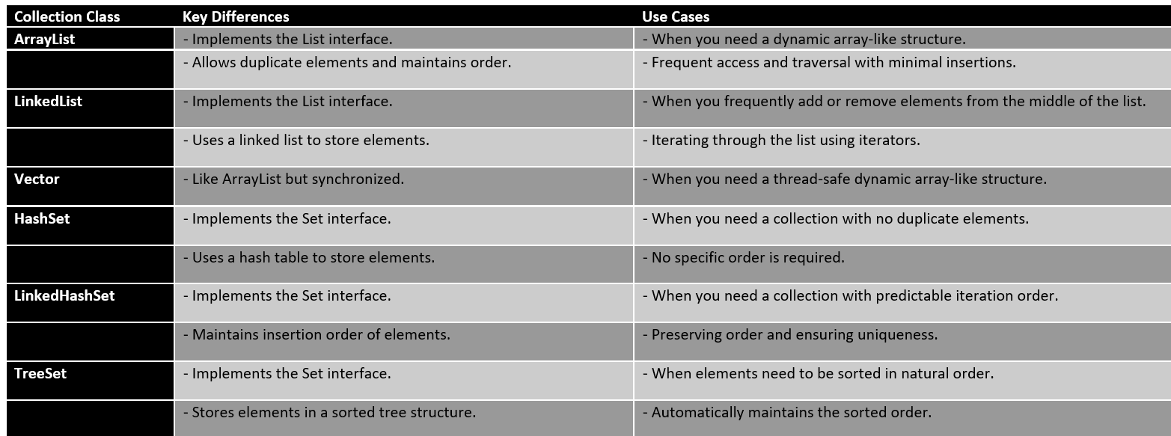

Slide 103
